Slide 1
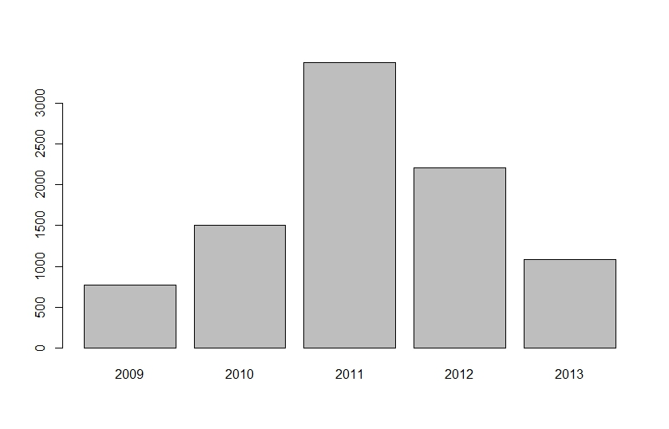
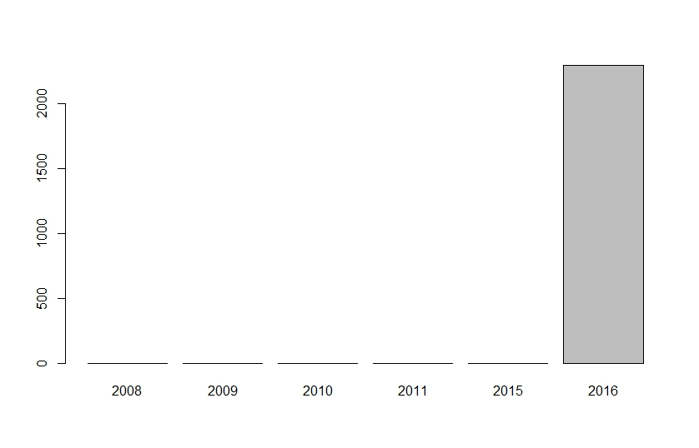
Sample size by year by study area (500m threshold)
NL (left) RMNP (right)

Slide 2
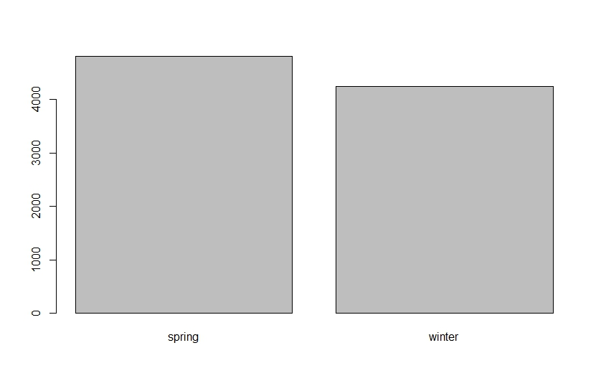
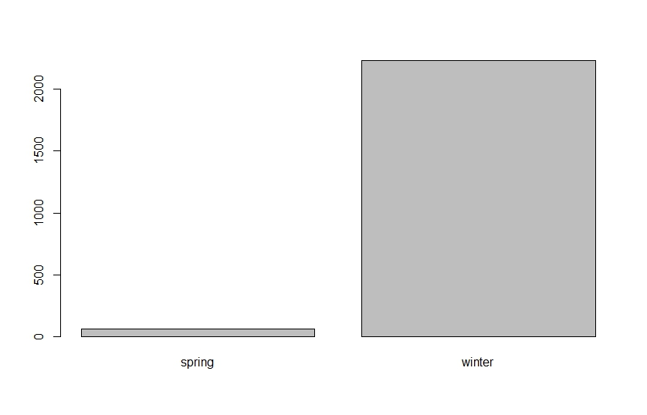
Sample size by season by study area (500m threshold)
NL (left) RMNP (right)

Slide 3
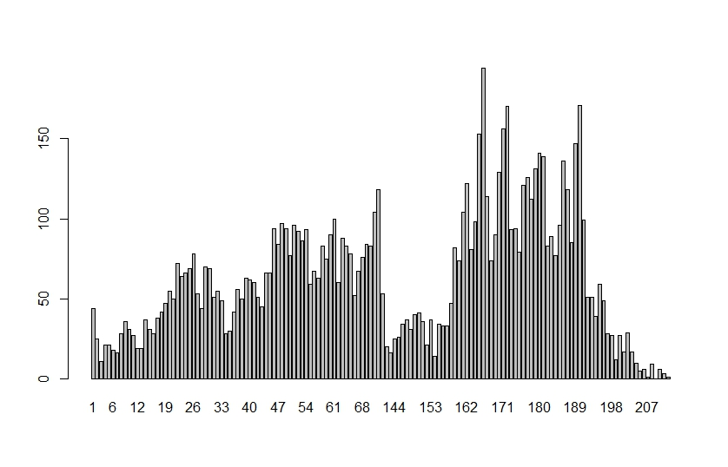
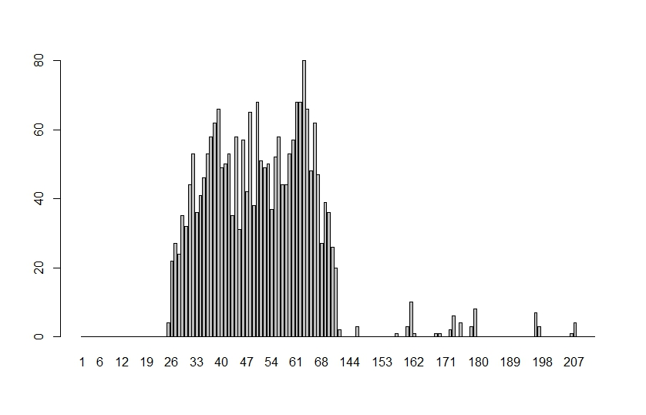
Sample size by day of the year by study area (500m threshold)
NL (left) RMNP (right)

Slide 4
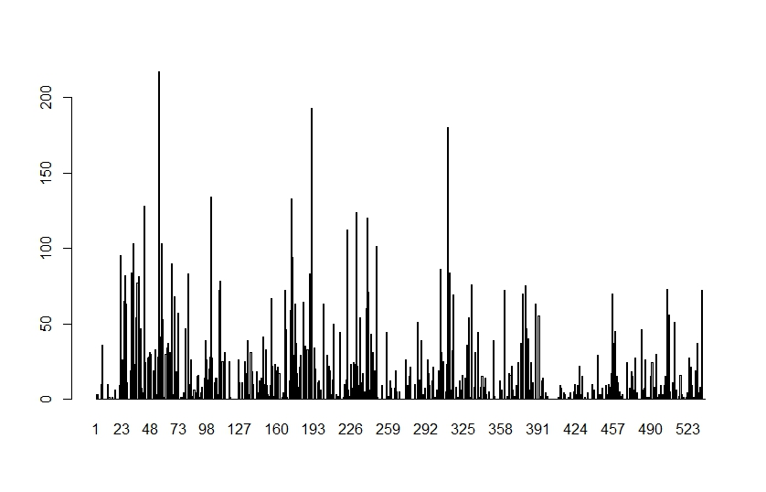
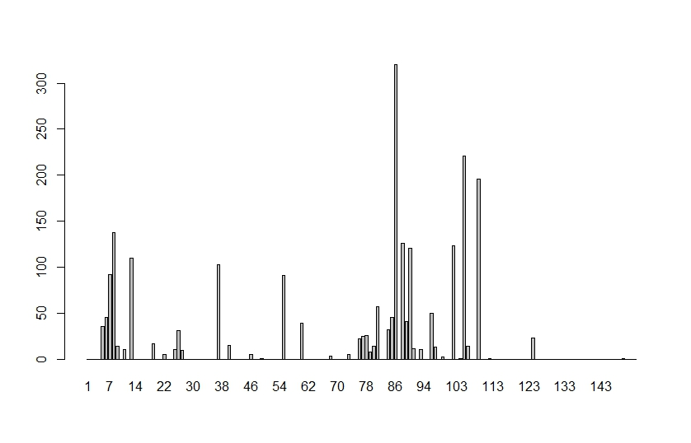
Sample size by dyad ID by study area (500m threshold)
NL (left) RMNP (right)

